Slide 1
Pontifical Catholic University of Rio Grande do Sul - Technology School
Integration of an Artificial Intelligence System with USV_SIM
Course: Intelligent Mobile Robots
2018
Student: Darlan Alves Jurak

Slide 2
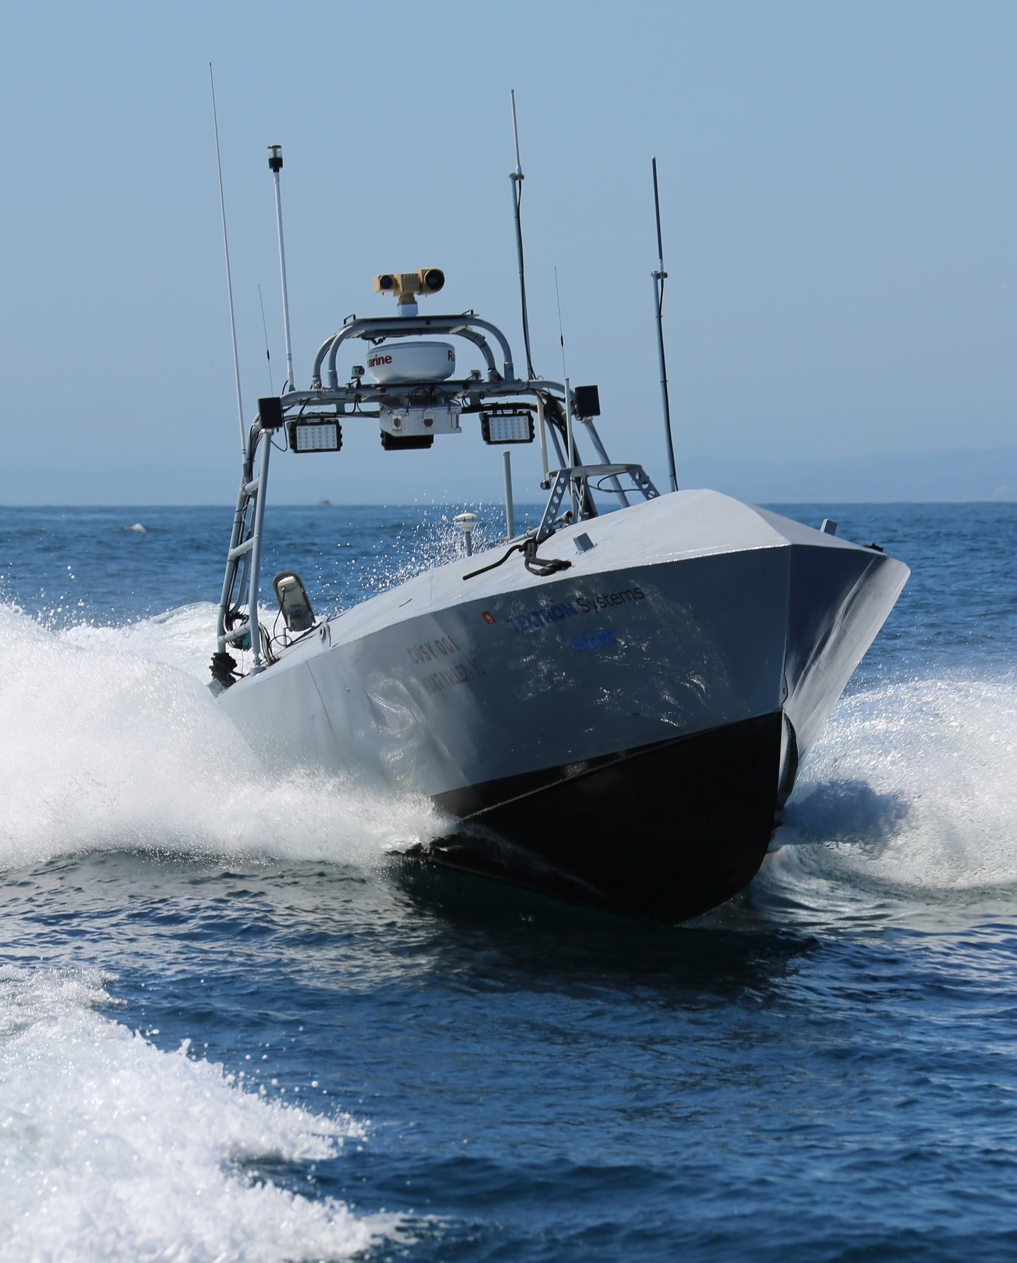
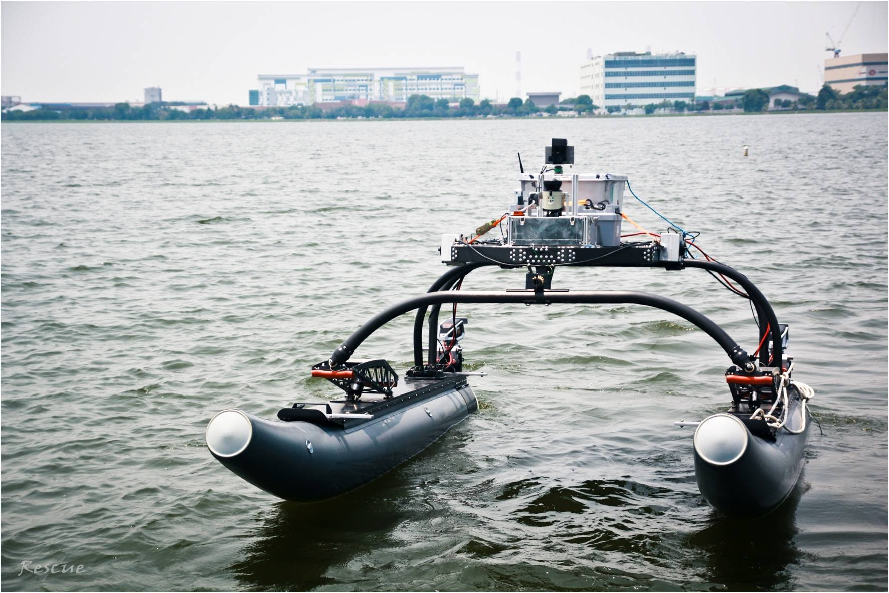
Unmanned Surface Vehicles (USVs)
EDIT IN GOOGLE SLIDES
Click on the button under the presentation preview that says "Use as Google Slides Theme".
You will get a copy of this document on your Google Drive and will be able to edit, add or delete slides.
You have to be signed in to your Google account.
EDIT IN POWERPOINT®
Click on the button under the presentation preview that says "Download as PowerPoint template". You will get a .pptx file that you can edit in PowerPoint.
Remember to download and install the fonts used in this presentation (you’ll find the links to the font files needed in the Presentation design slide)
More info on how to use this template at www.slidescarnival.com/help-use-presentation-template
This template is free to use under Creative Commons Attribution license. You can keep the Credits slide or mention SlidesCarnival and other resources used in a slide footer.

Slide 3
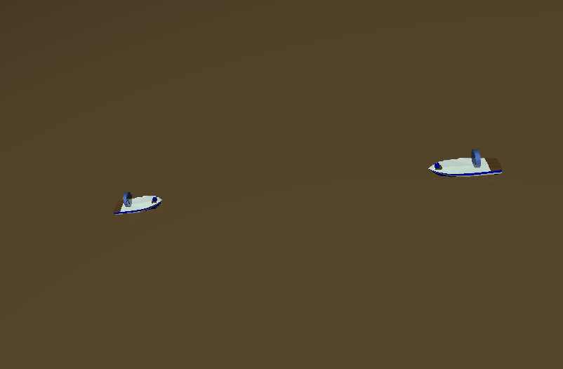
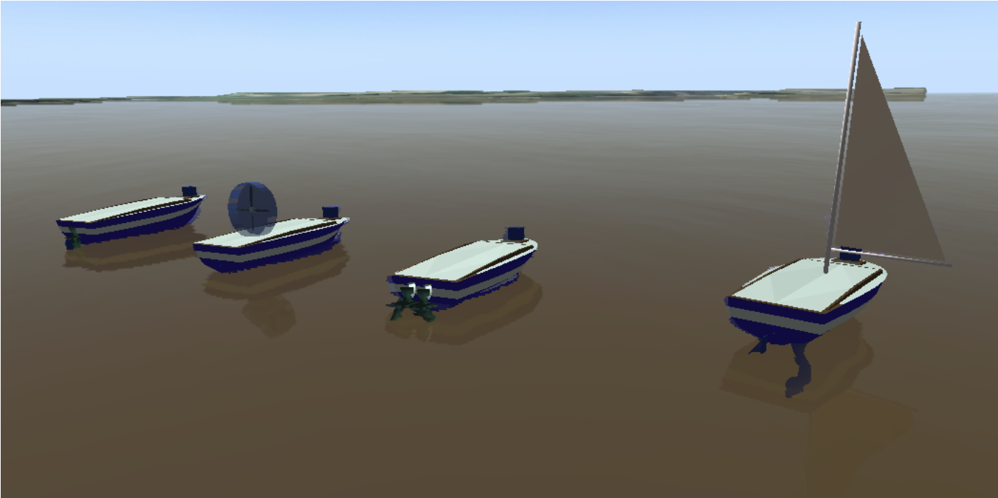
USV_SIM (Simulated Environment for Unmanned Surface Vehicles )
EDIT IN GOOGLE SLIDES
Click on the button under the presentation preview that says "Use as Google Slides Theme".
You will get a copy of this document on your Google Drive and will be able to edit, add or delete slides.
You have to be signed in to your Google account.
EDIT IN POWERPOINT®
Click on the button under the presentation preview that says "Download as PowerPoint template". You will get a .pptx file that you can edit in PowerPoint.
Remember to download and install the fonts used in this presentation (you’ll find the links to the font files needed in the Presentation design slide)
More info on how to use this template at www.slidescarnival.com/help-use-presentation-template
This template is free to use under Creative Commons Attribution license. You can keep the Credits slide or mention SlidesCarnival and other resources used in a slide footer.

Slide 4

Convention on the International Regulations for Preventing Collisions at Sea, 1972 (COLREGs)
EDIT IN GOOGLE SLIDES
Click on the button under the presentation preview that says "Use as Google Slides Theme".
You will get a copy of this document on your Google Drive and will be able to edit, add or delete slides.
You have to be signed in to your Google account.
EDIT IN POWERPOINT®
Click on the button under the presentation preview that says "Download as PowerPoint template". You will get a .pptx file that you can edit in PowerPoint.
Remember to download and install the fonts used in this presentation (you’ll find the links to the font files needed in the Presentation design slide)
More info on how to use this template at www.slidescarnival.com/help-use-presentation-template
This template is free to use under Creative Commons Attribution license. You can keep the Credits slide or mention SlidesCarnival and other resources used in a slide footer.
Rule 14 – Head-on Situation: When two power-driven vessels are meeting on reciprocal or nearly reciprocal courses so as to involve risk of collision, each shall alter her course to starboard so that each shall pass on the port side of the other.

Slide 5
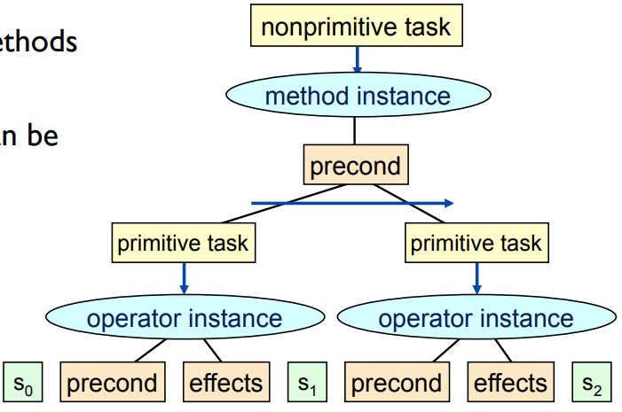
Hierarchical Task Network (HTN) - AI
EDIT IN GOOGLE SLIDES
Click on the button under the presentation preview that says "Use as Google Slides Theme".
You will get a copy of this document on your Google Drive and will be able to edit, add or delete slides.
You have to be signed in to your Google account.
EDIT IN POWERPOINT®
Click on the button under the presentation preview that says "Download as PowerPoint template". You will get a .pptx file that you can edit in PowerPoint.
Remember to download and install the fonts used in this presentation (you’ll find the links to the font files needed in the Presentation design slide)
More info on how to use this template at www.slidescarnival.com/help-use-presentation-template
This template is free to use under Creative Commons Attribution license. You can keep the Credits slide or mention SlidesCarnival and other resources used in a slide footer.

Slide 6
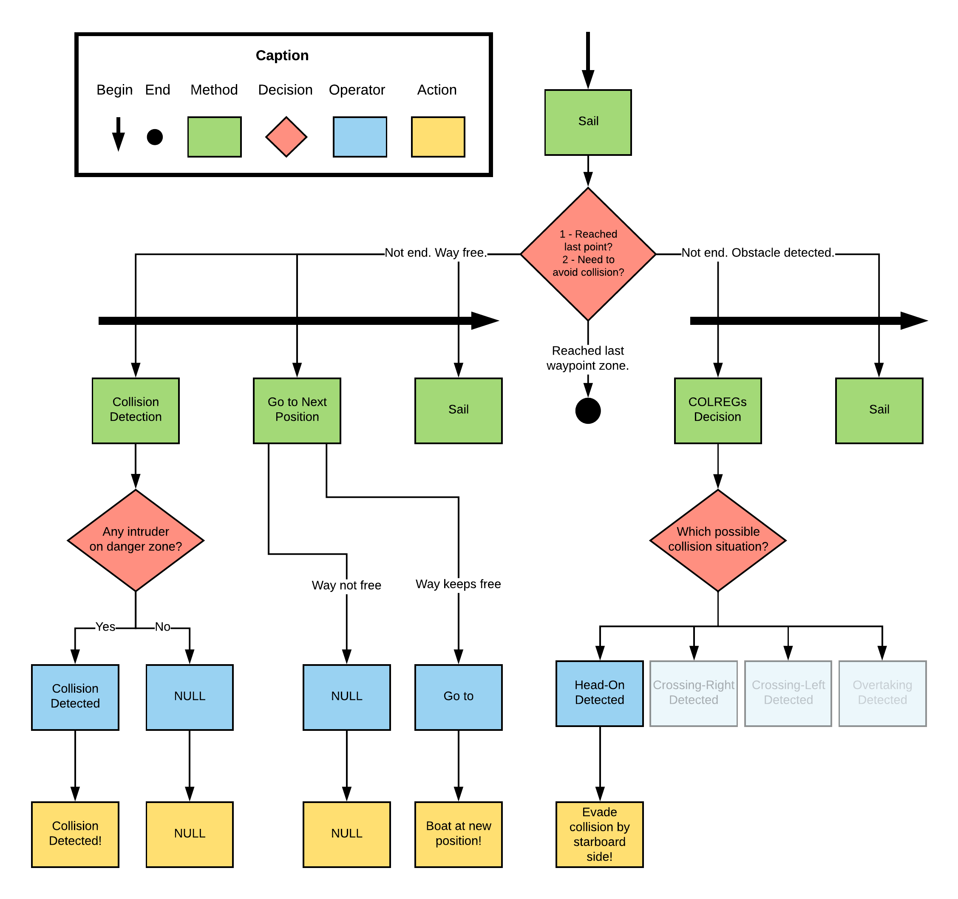
Hierarchical Task Network (HTN) - AI
EDIT IN GOOGLE SLIDES
Click on the button under the presentation preview that says "Use as Google Slides Theme".
You will get a copy of this document on your Google Drive and will be able to edit, add or delete slides.
You have to be signed in to your Google account.
EDIT IN POWERPOINT®
Click on the button under the presentation preview that says "Download as PowerPoint template". You will get a .pptx file that you can edit in PowerPoint.
Remember to download and install the fonts used in this presentation (you’ll find the links to the font files needed in the Presentation design slide)
More info on how to use this template at www.slidescarnival.com/help-use-presentation-template
This template is free to use under Creative Commons Attribution license. You can keep the Credits slide or mention SlidesCarnival and other resources used in a slide footer.

Slide 7
DEVELOPED WORK
Integrate HTN planning with USV_SIM

Slide 8
DEVELOPED WORK - Integrate HTN planning with USV_SIM
Step 0
USV_SIM
ROS
JSHOP

Slide 9
DEVELOPED WORK - Integrate HTN planning with USV_SIM
Step 1
HTN - Plan
USV_SIM
ROS
JSHOP

Slide 10
DEVELOPED WORK - Integrate HTN planning with USV_SIM
Step 2
HTN - Plan
USV_SIM
ROS
USV_GUIDER
JSHOP

Slide 11
DEVELOPED WORK - Integrate HTN planning with USV_SIM
Step 3
HTN - Plan
USV_SIM
ROS
USV_GUIDER
JSHOP

Slide 12
DEVELOPED WORK - Integrate HTN planning with USV_SIM
Step 5
HTN - Plan
USV_SIM
ROS
USV_GUIDER
JSHOP
Env. Description

Slide 13
DEVELOPED WORK - Integrate HTN planning with USV_SIM
Step 6
HTN - Plan
USV_SIM
ROS
USV_GUIDER
JSHOP
Env. Description

Slide 14
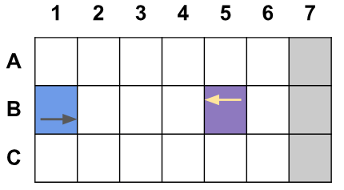
DEVELOPED WORK

Slide 15
HTN - Plan
USV_SIM
ROS
USV_GUIDER
JSHOP
Env. Description

Slide 17
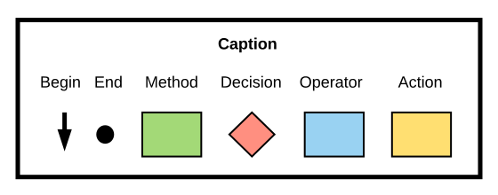
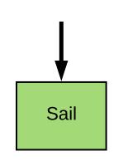
DEVELOPED WORK
LOCAL GUIDANCE SYSTEM
Avoid head-on collision situations
COLREGs-Compliant
Based on HTN
Developed using JSHOP2
SIMPLE MISSION
GRID
HIERARCHICAL TASK NETWORK
Sail

Slide 18
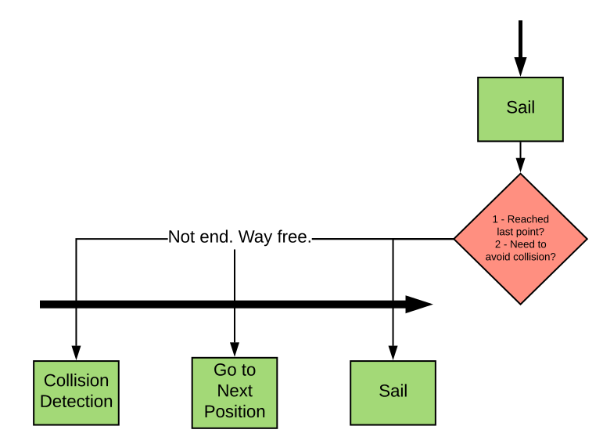
DEVELOPED WORK
LOCAL GUIDANCE SYSTEM
Avoid head-on collision situations
COLREGs-Compliant
Based on HTN
Developed using JSHOP2
SIMPLE MISSION
GRID
HIERARCHICAL TASK NETWORK
Sail
Collision Detection
Go to the next position

Slide 19
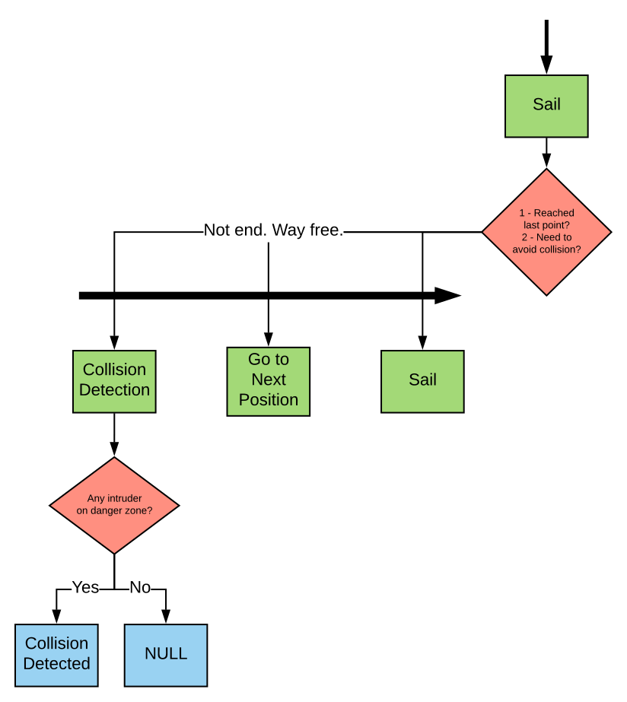
DEVELOPED WORK
LOCAL GUIDANCE SYSTEM
Avoid head-on collision situations
COLREGs-Compliant
Based on HTN
Developed using JSHOP2
SIMPLE MISSION
GRID
HIERARCHICAL TASK NETWORK
Sail
Collision Detection
Go to the next position

Slide 20
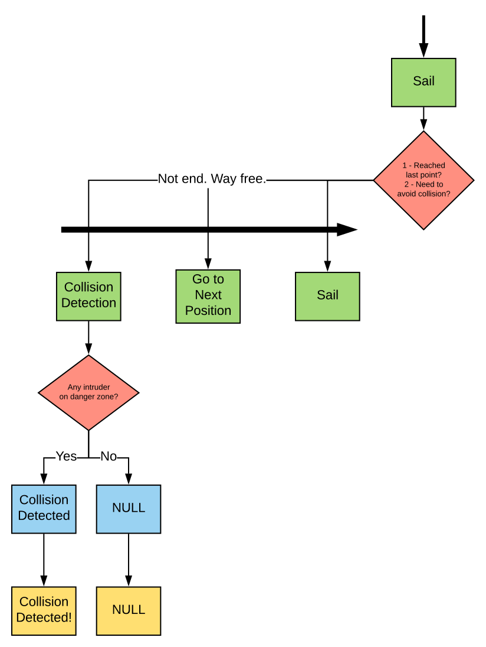
DEVELOPED WORK
LOCAL GUIDANCE SYSTEM
Avoid head-on collision situations
COLREGs-Compliant
Based on HTN
Developed using JSHOP2
SIMPLE MISSION
GRID
HIERARCHICAL TASK NETWORK
Sail
Collision Detection
Go to the next position

Slide 21
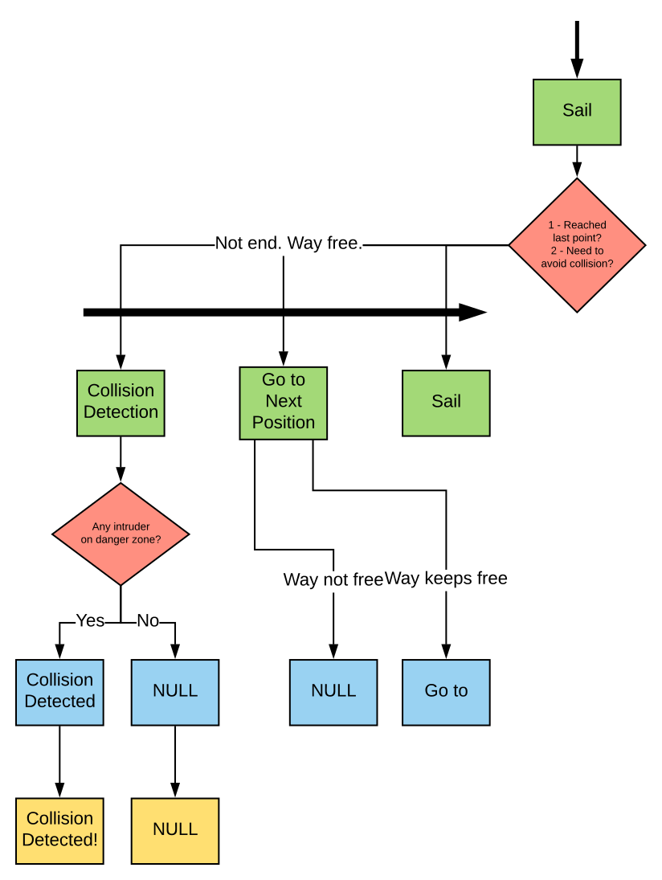
DEVELOPED WORK
LOCAL GUIDANCE SYSTEM
Avoid head-on collision situations
COLREGs-Compliant
Based on HTN
Developed using JSHOP2
SIMPLE MISSION
GRID
HIERARCHICAL TASK NETWORK
Sail
Collision Detection
Go to the next position

Slide 22
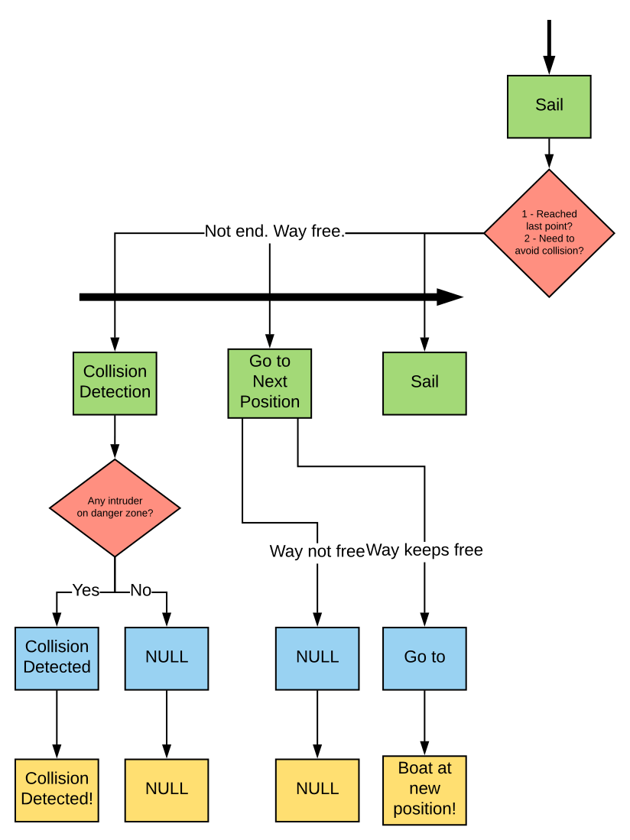
DEVELOPED WORK
LOCAL GUIDANCE SYSTEM
Avoid head-on collision situations
COLREGs-Compliant
Based on HTN
Developed using JSHOP2
SIMPLE MISSION
GRID
HIERARCHICAL TASK NETWORK
Sail
Collision Detection
Go to the next position

Slide 23
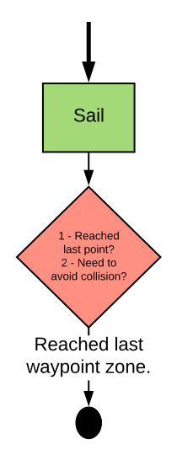
DEVELOPED WORK
LOCAL GUIDANCE SYSTEM
Avoid head-on collision situations
COLREGs-Compliant
Based on HTN
Developed using JSHOP2
SIMPLE MISSION
GRID
HIERARCHICAL TASK NETWORK
Sail
Collision Detection
Go to the next position

Slide 24
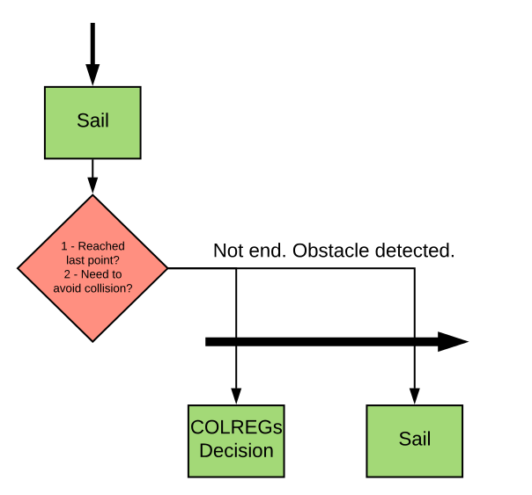
DEVELOPED WORK
LOCAL GUIDANCE SYSTEM
Avoid head-on collision situations
COLREGs-Compliant
Based on HTN
Developed using JSHOP2
SIMPLE MISSION
GRID
HIERARCHICAL TASK NETWORK
Sail
Collision Detection
Go to the next position
Avoid according to the COLREGs

Slide 25
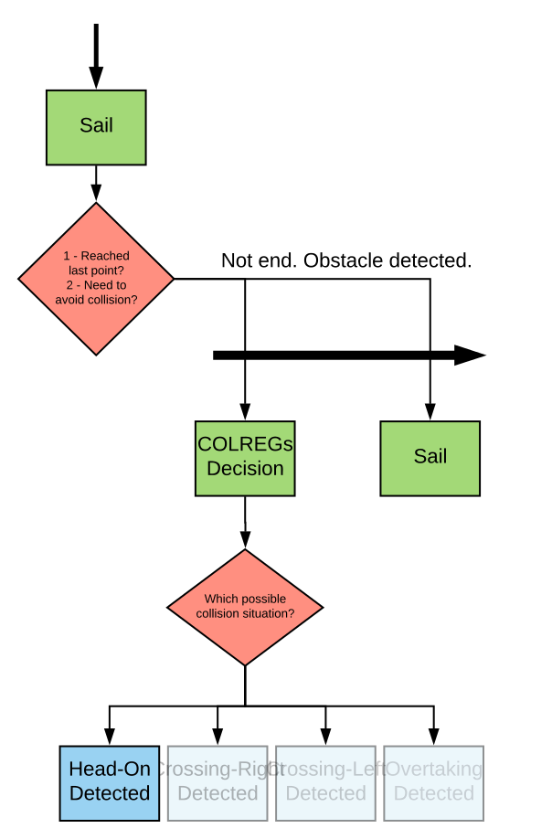
DEVELOPED WORK
LOCAL GUIDANCE SYSTEM
Avoid head-on collision situations
COLREGs-Compliant
Based on HTN
Developed using JSHOP2
SIMPLE MISSION
GRID
HIERARCHICAL TASK NETWORK
Sail
Collision Detection
Go to the next position
Avoid according to the COLREGs

Slide 26
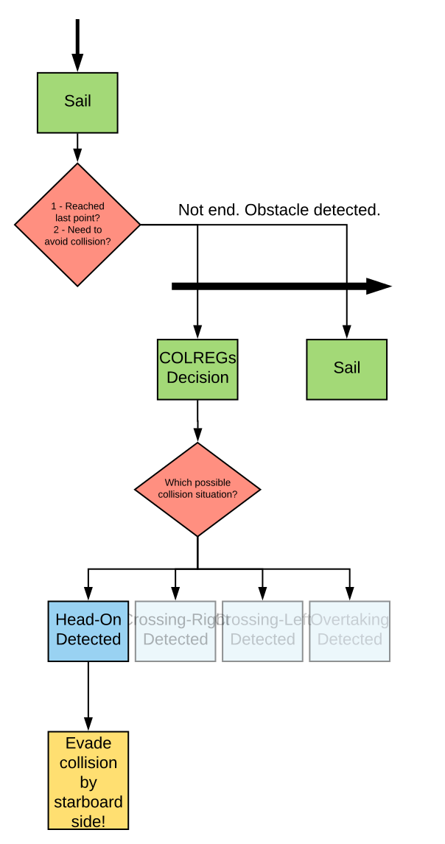
DEVELOPED WORK
LOCAL GUIDANCE SYSTEM
Avoid head-on collision situations
COLREGs-Compliant
Based on HTN
Developed using JSHOP2
SIMPLE MISSION
GRID
HIERARCHICAL TASK NETWORK
Sail
Collision Detection
Go to the next position
Avoid according to the COLREGs

Slide 27
DEVELOPED WORK
LOCAL GUIDANCE SYSTEM
Avoid head-on collision situations
COLREGs-Compliant
Based on HTN
Developed using JSHOP2
SIMPLE MISSION
GRID
HIERARCHICAL TASK NETWORK
Sail
Collision Detection
Go to the next position
Avoid according to the COLREGs

Slide 28
EXPERIMENT
SIMPLE MISSION
Go ahead and stops when reached predefined end points.

Slide 29
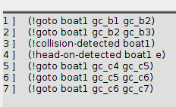
EXPERIMENT
JSHOP 2 Output
Defined plan.

Slide 30
Conclusion and Future Work
CONCLUSION
Integration done
FUTURE WORK
More realistic environment description based on
LiDAR
Roger’s work
Implementation of other danger situation such as
Overtaking
Crossing
Encounter between different types of ships
Coastal proximity
Narrow Channels
Waypoints
ROSPlan

Slide 31
Thanks!

Slide 32
Q&A

